Slide 1

RRMG Summerfest Presentation

Slide 2
Intro to RRMG (Joe KE0FF)
ADALM-Pluto (Ray, W5IFS)
What’s a Microwave Beacon (Jenner, KK6RUM)
A Survey of Roving Methods (Ray, W5IFS)
Q&A

Slide 3
Intro to RRMG

Slide 4
RMG Activities
Charter:
A “Microwave” group, but we support activities from 6m and up
Dedicated to the art and science of microwave weak-signal operation
Monthly Meetings
1st Saturday of each month (some exceptions by prior arrangement when conflicts arise, such as Summerfest)
Maudie’s Hill Country Restaurant in Bee Caves (in upstairs “bar” area)
1100L, lasts about an hour most months, sometimes a bit longer
Agenda usually includes club business and presentations by members
Membership Requirements
Open to all hams. No dues. Just show up and announce your membership.

Slide 5
RMG Activities (cont’d)
Web Site
http://k5rmg.com/ http://k5rmg.com/
E-Mail Reflector
http://k5rmg.com/mailman/listinfo/rmg_k5rmg.com
RRMG Nets
Sunday @2100L on 144.150 MHz
222 Tuesday @2000L on 222.1 MHz
432 ‘n up Wednesday @2000L on 432.1 MHz, then up the bands

Slide 6
RMG Activities (cont’d)
Beacons (K5RMG, EM00xh)
144.295 MHz
222.060 MHz
432.345 MHz
902.350 MHz
1296.400 MHz
2304.045 MHz
5760.150 MHz
10368.150 MHz
Many others in the area, see http://k5rmg.com/beacons/ for a more complete list

Slide 7
ADALM-Pluto
A Microwave Software Defined Radio

Slide 8
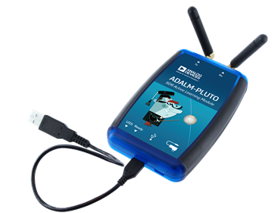
What is it?
ADALM = Analog Devices Active Learning Module
A hardware and software platform for university students or those who just want to learn about modern Radios
325 MHz to 3800 MHz full duplex SDR
Uses Analog Devices AD9363 Transceiver Front End IC and Zynq Z-7010 FPGA
$149.00 list price from Analog Devices
$99.00 or less from Mouser, Digi-Key, Newark, RichardsonRFPD, and Arrow
Also from Amazon but out of stock

Slide 9
Block Diagram

Slide 10
Hardware Specifications
USB 2.0 Connection to PC
Separate SMA for Receive and Transmit
12 Bit ADC and DAC
65.2 kSPS to 61.44 MSPS
20 MHz I/Q IF bandwidth
TX power 7 dBm
RX NF < 3.5 dB
ARM Cortex A9 at 667 MHz

Slide 11
Software Resources
Linux firmware control to interface to PC
Devices
Mass Storage
Serial Port (console)
Ethernet emulation
Libiio Bulk USB for SDR data transfer
Open Source Windows device drivers
Open Source Linux device drivers
SDR GUI support
GnuRadio
Gqrx
SDR#
Control Hardware
PC, Raspberry Pi, BeagleBone, 96boards, etc.

Slide 12
Extended Frequency Range
AD9364 is 1x1 version of AD9363 which is 2x2
Same 144 pin package
Telling the drivers to use AD9364 will potentially extend from 70 MHz to 6 GHz!

Slide 13
What’s a Microwave Beacon?
Roadrunners Microwave Group 3.4 GHz Beacon Project

Slide 14
What’s a Beacon? Why Have One?
Notes:
Introduce myself, overview of what presentation is about

Slide 15
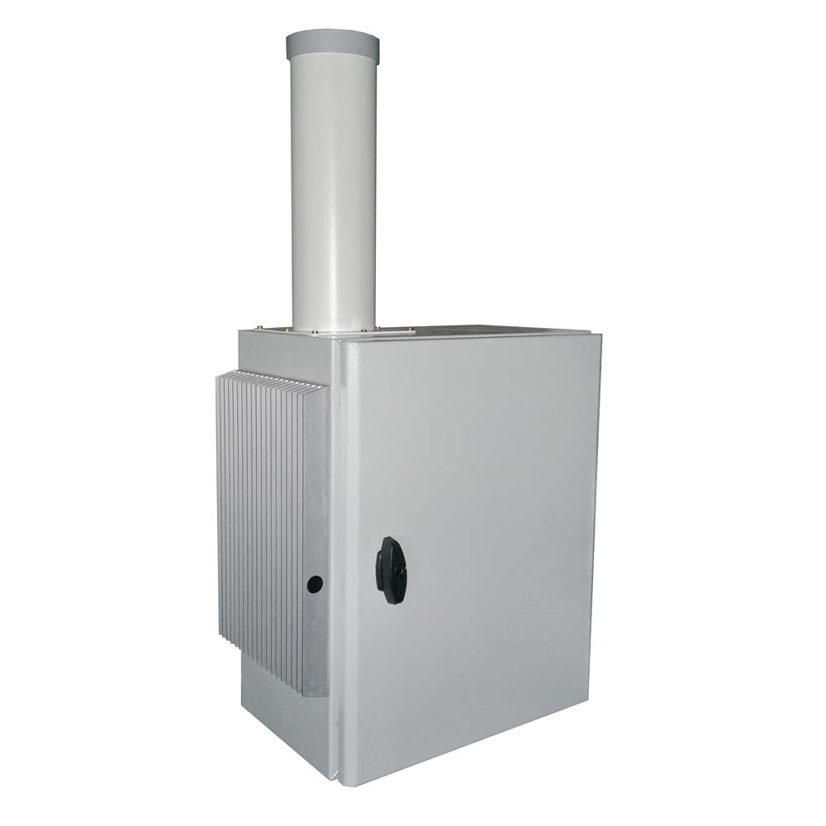

Slide 16
What does a Microwave Beacon do?
Sends a message, usually in Morse code, on a published frequency
Mandatory
Morse code identifier “K5RMG/B”
Optional
Beacon location “EM10”
Varying power levels (10W, 1W, 0.1W for example)

Slide 17
Uses
Propagation Indicator -- are conditions good?
Frequency Reference -- am I on frequency?
Signal Strength -- how well is my receiver / antenna working?

Slide 18
How do You Build a Microwave Beacon?
What do we need?
Something to generate CW with the identifier and message
Often it’s desirable to amplify the CW message
An antenna to transmit the CW message
Also: power, cooling, feedline, test equipment, etc.

Slide 19
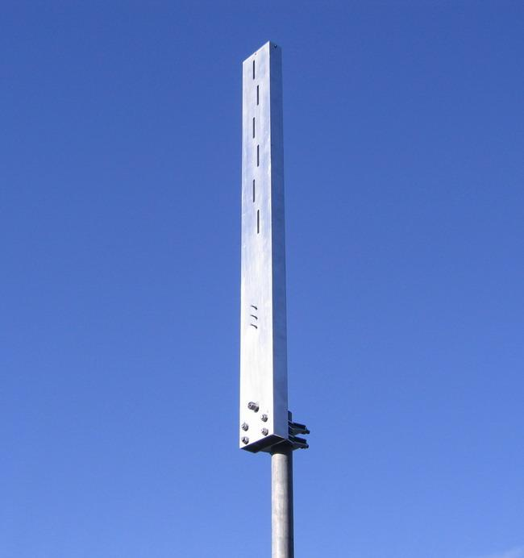
Antenna
Slotted waveguide antenna is to be constructed with 6 slots.
Provides an omnidirectional, horizontally-polarized radiation pattern with some gain.
Must somehow be sealed to keep water, insects and debris out.

Slide 20
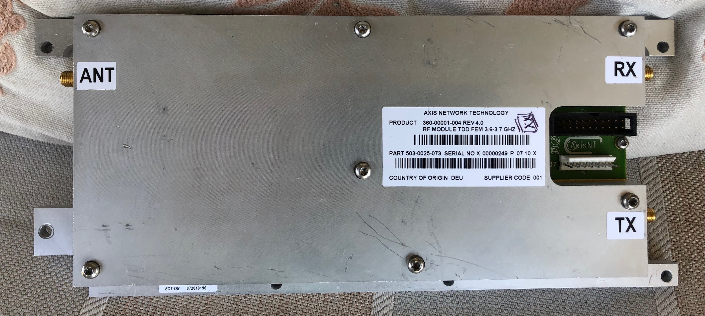
Power Amplifier
Repurposed WiMax commercial RF unit.
+28 dBg on TX
15W max output

Slide 21
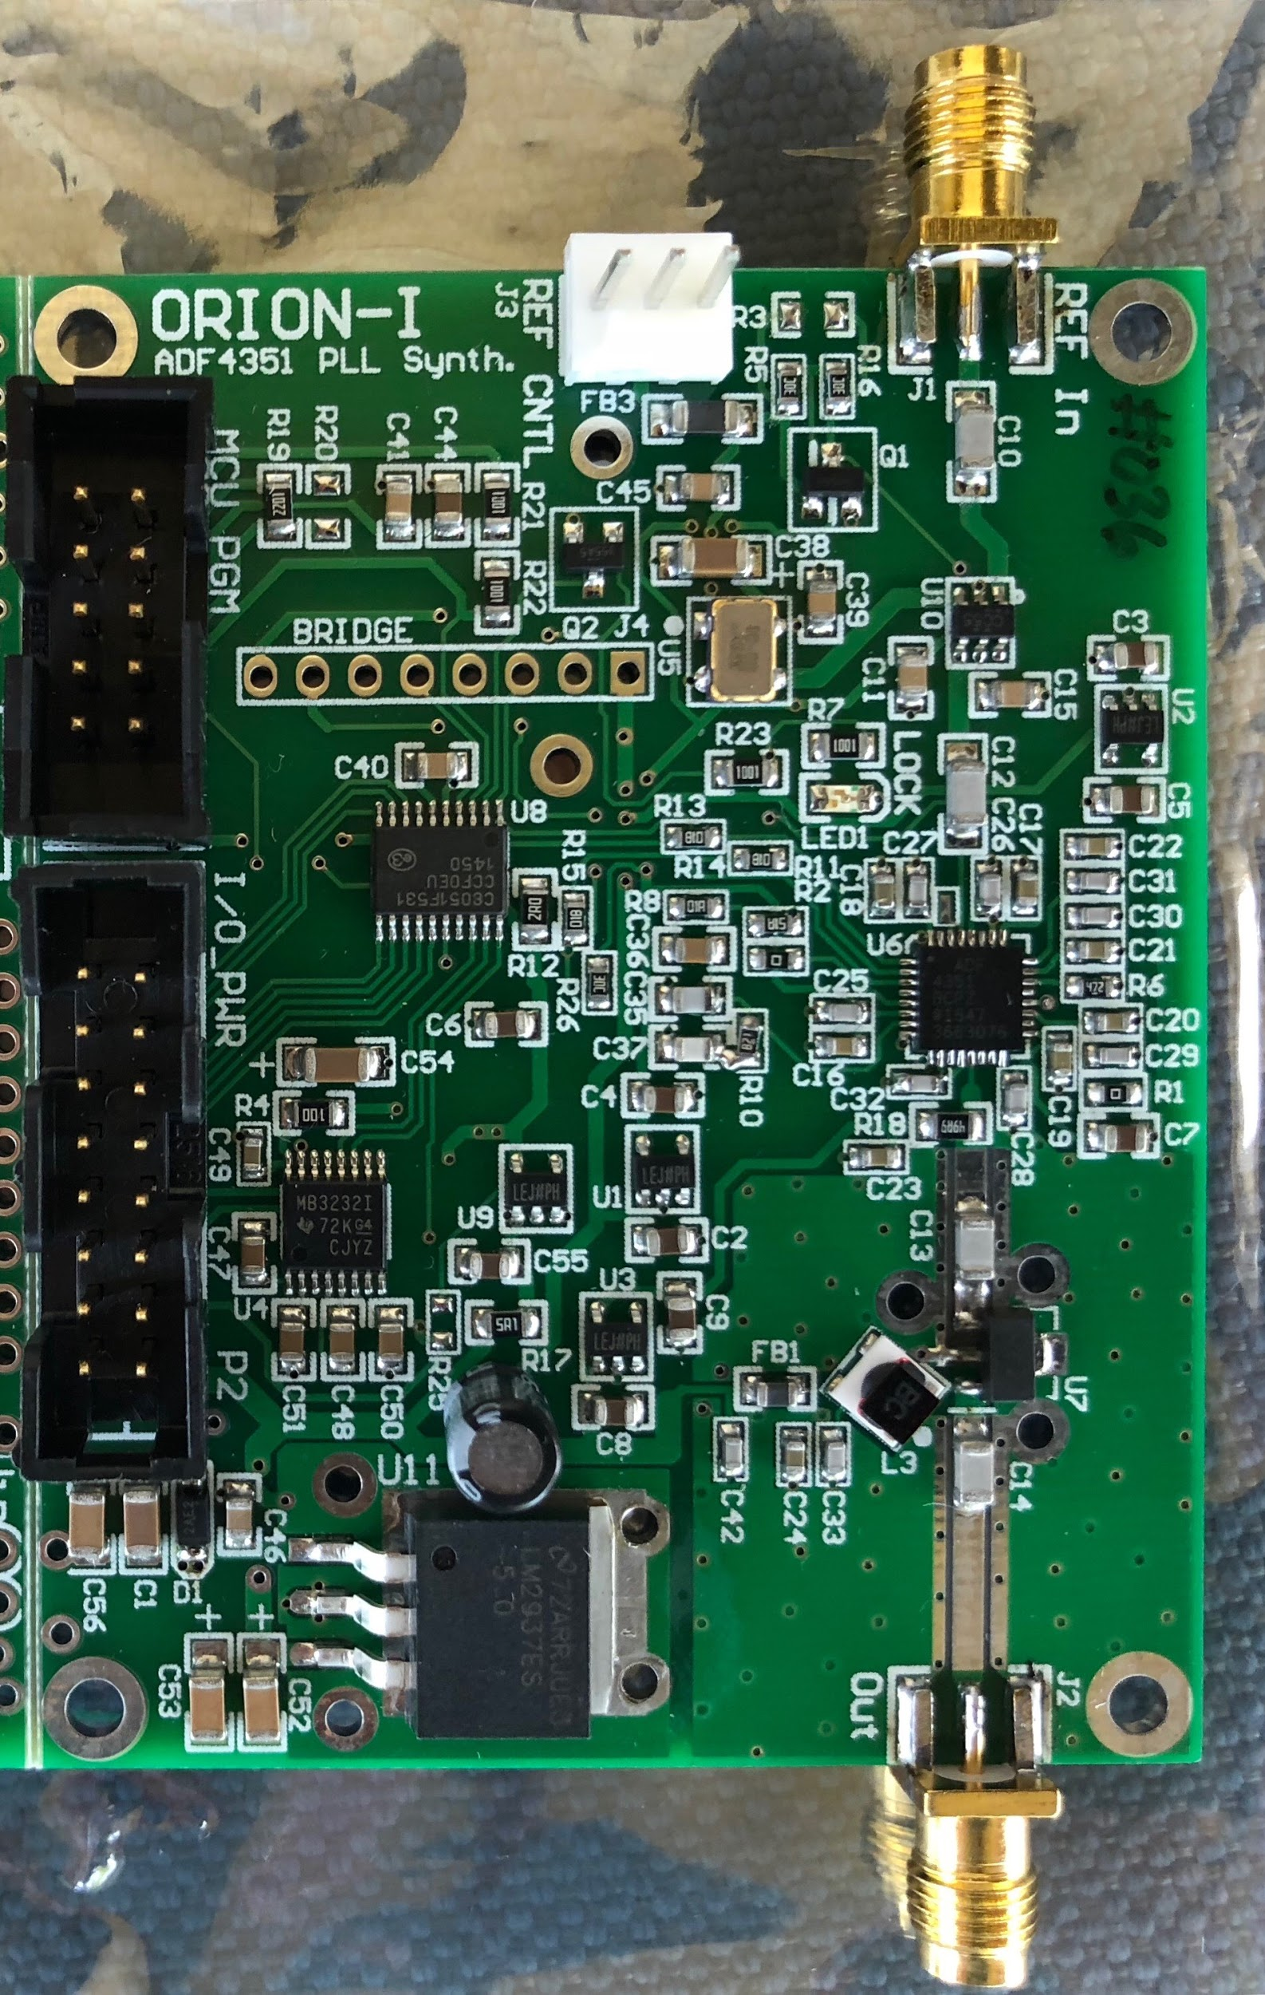
Frequency Synthesizer
Orion I from KE0FF
35 MHz to 4.4 GHz
+15 dBm +/- 2 dBm
Accepts external reference clock
Low Phase Noise

Slide 22
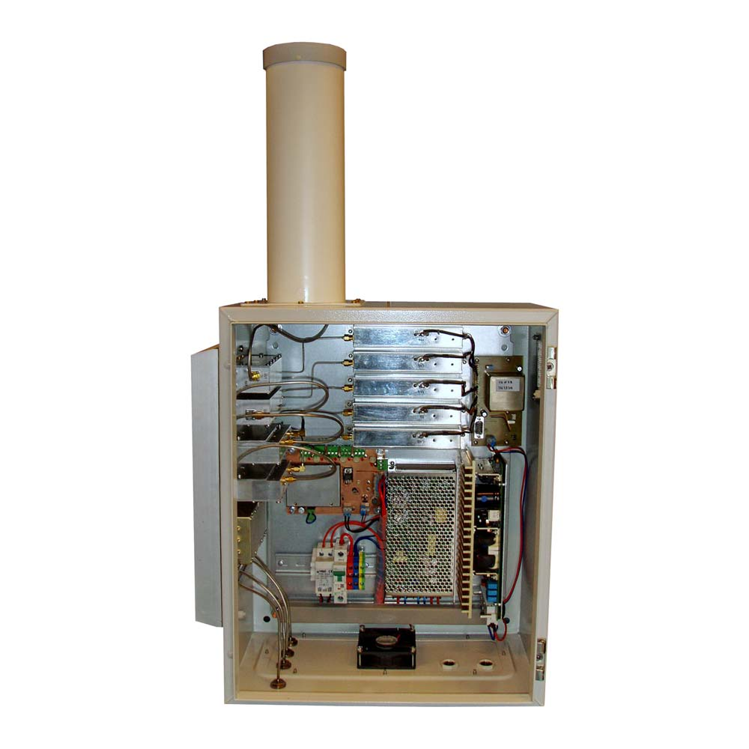
Enclosure
We have to keep the RF and electrical components out of the elements.
The enclosure also must provide airflow to remove heat.
Also, keep the bugs out.

Slide 23
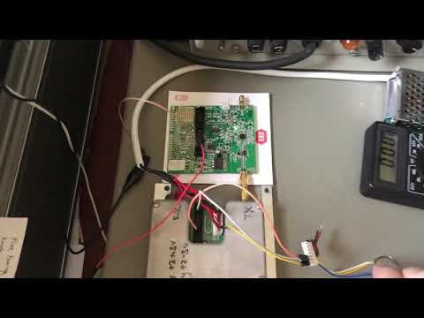
Microwave Beacon Considerations
Notes:
Frequency accuracy/stability - since ppl use as a freq. Reference, good to be able to say what freq beacon is on
Feedline losses - LMR400 (7 dB/100’ @ 2.4 GHz -- lost almost 60% of power)
Antenna -- can’t always go out and buy omni microwave antennas, also fun to make

Slide 24
Microwave Beacon Considerations
Frequency Accuracy & Stability
Feedline Losses
Antenna
Environmental: Cooling, Keeping it Dry, Keeping Spiders Out
Notes:
Frequency accuracy/stability - since ppl use as a freq. Reference, good to be able to say what freq beacon is on
Feedline losses - LMR400 (7 dB/100’ @ 2.4 GHz -- lost almost 60% of power)
Antenna -- can’t always go out and buy omni microwave antennas, also fun to make

Slide 25
Questions?

Slide 26
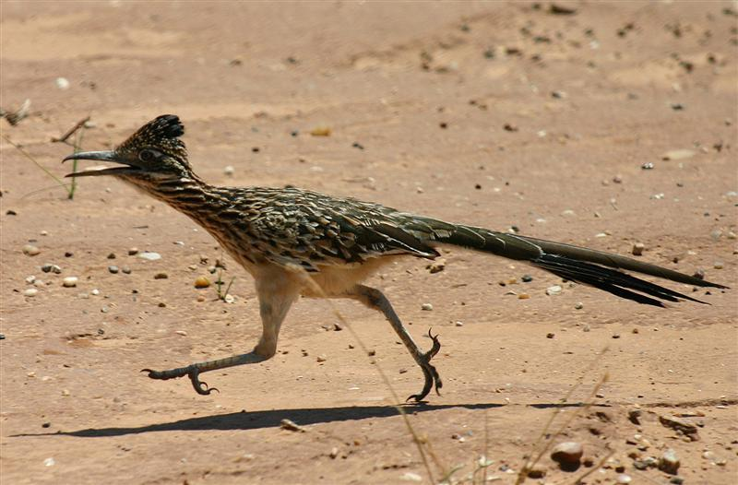
Thanks!
Jenner Lochridge
KK6RUM
Roadrunners Microwave Group
k5rmg.org
Austin, TX

Slide 27
A Survey of Roving Methods

Slide 28
What is Roving? Roving : (noun/verb/adverb/cussword)
The fine art of stuffing every piece of VHF and Microwave gear you own into and onto your vehicle... then driving hundreds or thousands of miles while contacting the same people over and over again!

Slide 29
Roving Equipment
A Vehicle
1 or more VHF or higher radio
Some sort of Antenna
After that..... It’s just Style points!

Slide 30
Types of Rovers
Run and Gun
Shoot and Scoot
Stop and Plop

Slide 31
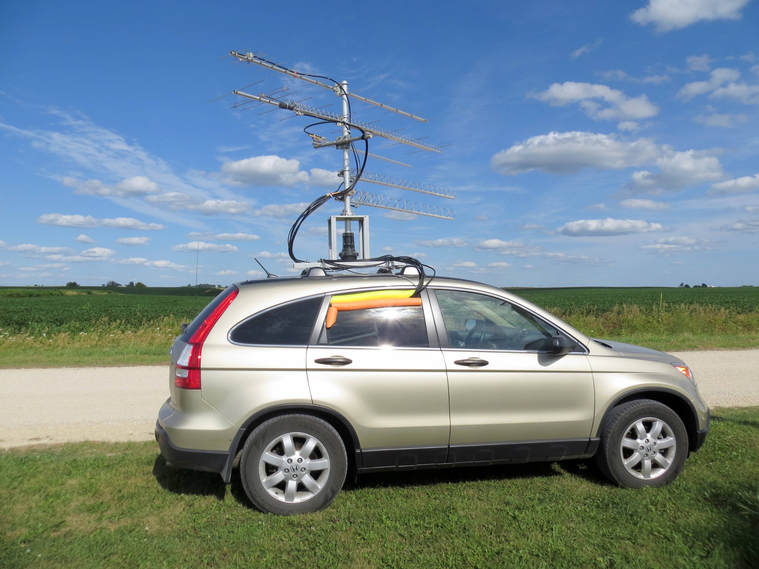
Run and Gun or Shoot and Scoot

Slide 32
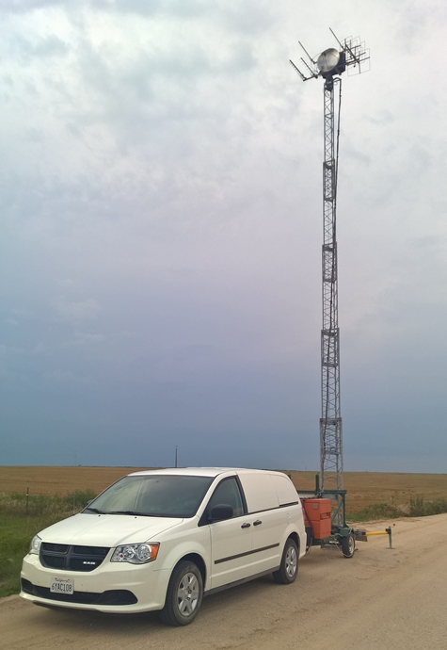
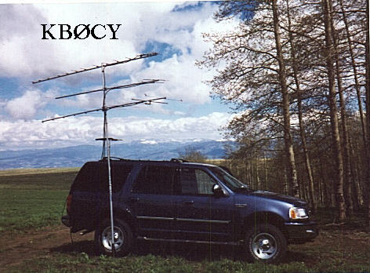
Stop and Plop

Slide 33
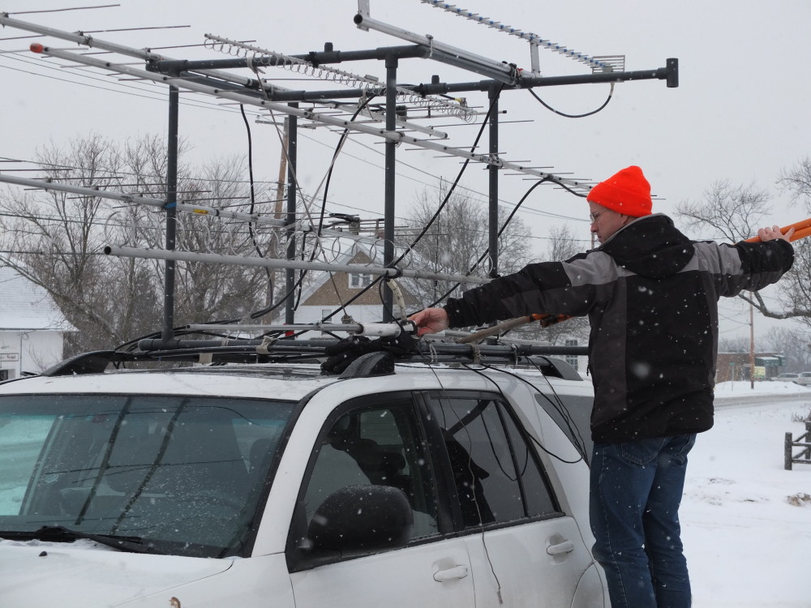
Shoot and Scoot

Slide 34


Slide 35
Run and Gun

Slide 36
Partners, Packs, and Pileups
Roving Classes
–Limited Rover –1 or 2 ops, 4 lower bands
–Classic Rover –2 ops, Unlimited bands
–Unlimited Rover –Anything Goes*
•Small Group Roving
Family Stations
•Pack Roving
* well… almost anything….

Slide 37
Plan, Publish, and Play your Route!

Slide 38
Recent Changes to the Rules
Cell phone coordination
Slack Channel
Traditional coordination on 144.260

Slide 39
Take along a few tools

Slide 40
You are gonna break stuff…

